Slide 1
Unit- IV
HCI –Design Process

Slide 2
Unit- IV: Contents
What is interaction design?
The software design process
User focus
Scenarios, Navigation Design, Screen Design
Prototyping techniques
Wire-Framing
Understanding the UI Layer and Its Execution Framework
Model-View-Controller(MVC) Framework.

Slide 3
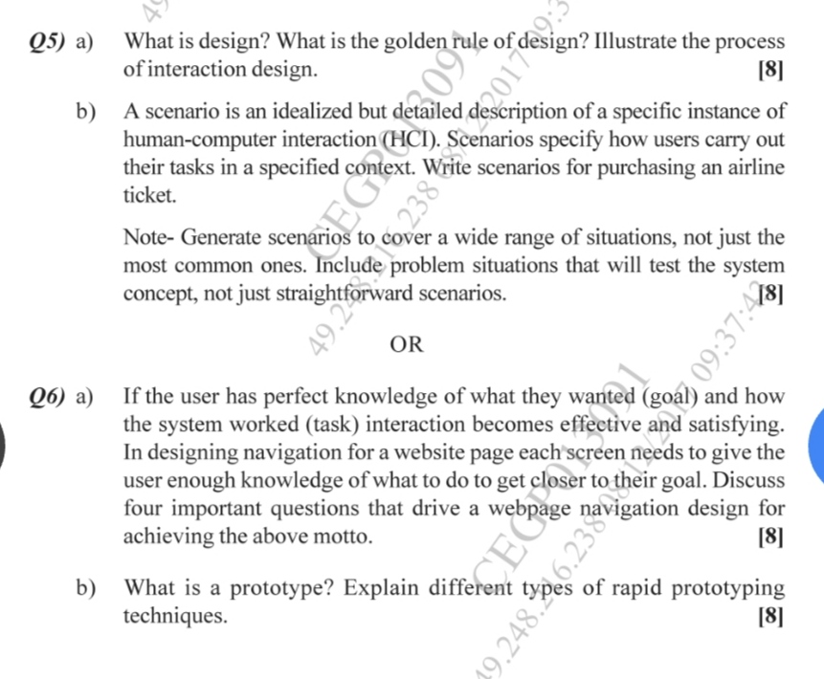


Slide 4
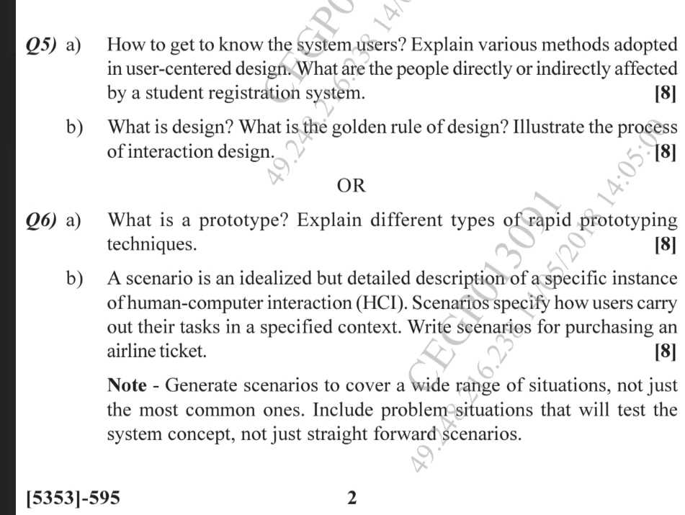

Slide 5
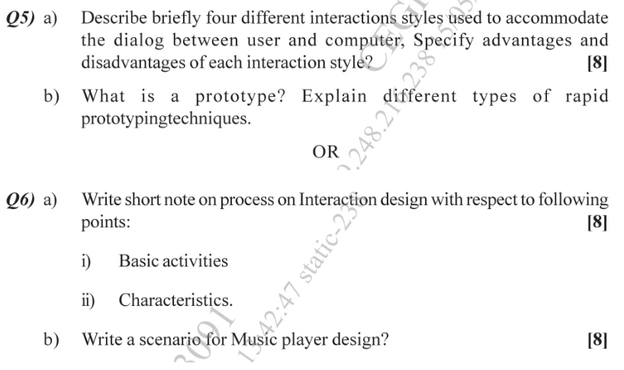

Slide 6
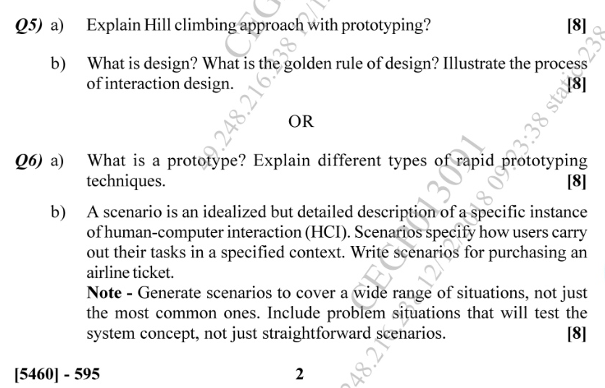

Slide 7
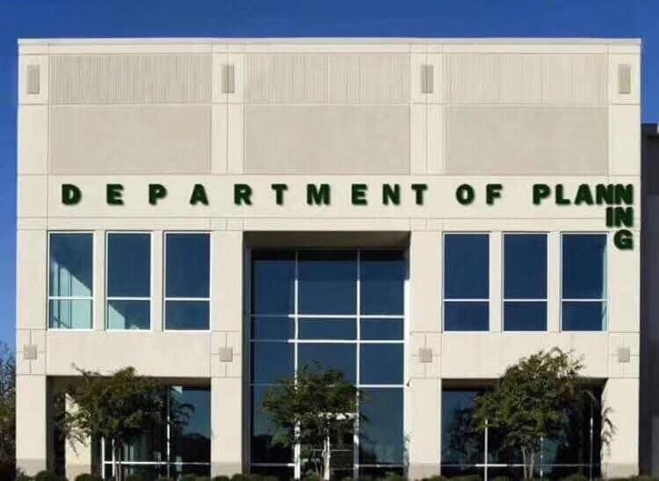

Slide 8
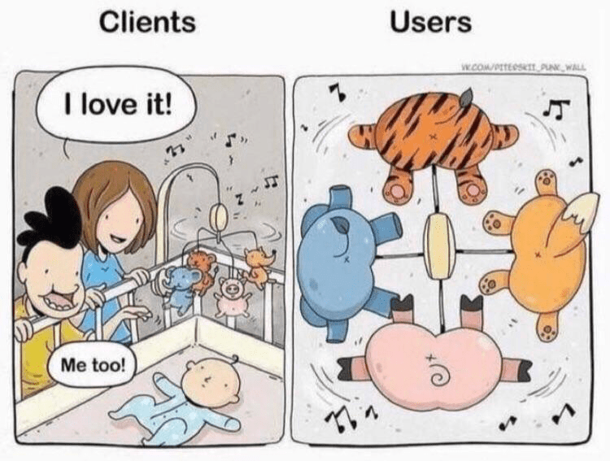

Slide 9
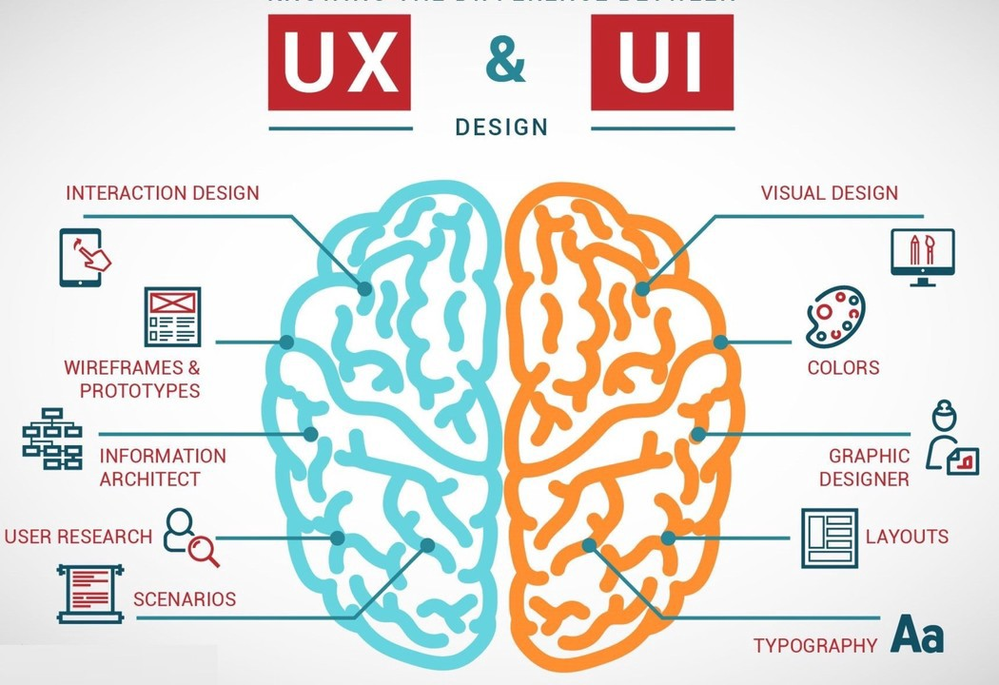

Slide 10



chapter 5
interaction design basics

Slide 11
interaction design basics
design:
      what it is, interventions, goals, constraints
the design process
      what happens when
users
      who they are, what they are like …
scenarios
      rich stories of design
navigation
      finding your way around a system
iteration and prototypes
      never get it right first time!

Slide 12
interactions and interventions
design interactions not just interfaces
  not just the immediate interaction
  e.g. stapler in office – technology changes interaction style
    manual: write, print, staple, write, print, staple, …
    electric: write, print, write, print, …, staple
designing interventions not just artefacts
  not just the system, but also …
    documentation, manuals, tutorials
    what we say and do as well as what we make

Slide 13
what is design?

Slide 14
what is design?
achieving goals within constraints
goals - purpose
  who is it for, why do they want it
constraints
  materials, platforms
trade-offs

Slide 15
golden rule of design
understand your materials

Slide 16
for Human–Computer Interaction
understand your materials
understand computers
  limitations, capacities, tools, platforms
understand people
  psychological, social aspects
  human error
and their interaction …

Slide 17
To err is human
accident reports ..
  aircrash, industrial accident, hospital mistake
  enquiry … blames … ‘human error’
but …
  concrete lintel breaks because too much weight
  blame ‘lintel error’ ?
  … no – design error
  we know how concrete behaves under stress
human ‘error’ is normal
  we know how users behave under stress
  so design for it!
treat the user at least as well as physical materials!

Slide 18
Central message …
the user

Slide 19
The process of design
scenarios
task analysis
what is
wanted
guidelines
principles
analysis
interviews
ethnography
what is there
vs.
what is wanted
precise
specification
design
dialogue
notations
implement
and deploy
evaluation
heuristics
prototype
architectures
documentation
help

Slide 20
Steps …
requirements
  what is there and what is wanted …
analysis
  ordering and understanding
design
  what to do and how to decide
iteration and prototyping
  getting it right … and finding what is really needed!
implementation and deployment
  making it and getting it out there

Slide 21
… but how can I do it all ! !
limited time ⇒ design trade-off
usability?
  finding problems and fixing them?
  deciding what to fix?
a perfect system is badly designed
  too good ⇒ too much effort in design



Slide 23
user focus
know your user
personae
cultural probes

Slide 24
know your user
who are they?
probably not like you!
talk to them
watch them
use your imagination

Slide 25
persona
description of an ‘example’ user
  not necessarily a real person
use as surrogate user
  what would Betty think
details matter
  makes her ‘real’

Slide 26
example persona
Betty is 37 years old, She has been Warehouse Manager for five years and worked for Simpkins Brothers Engineering for twelve years. She didn’t go to university, but has studied in her evenings for a business diploma. She has two children aged 15 and 7 and does not like to work late. She did part of an introductory in-house computer course some years ago, but it was interrupted when she was promoted and could no longer afford to take the time. Her vision is perfect, but her right-hand movement is slightly restricted following an industrial accident 3 years ago. She is enthusiastic about her work and is happy to delegate responsibility and take suggestions from her staff. However, she does feel threatened by the introduction of yet another new computer system (the third in her time at SBE).

Slide 27

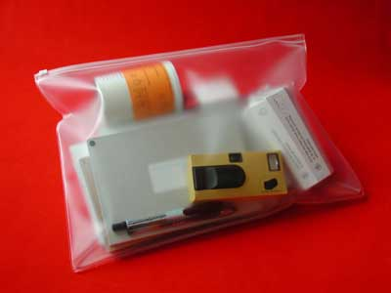
cultural probes
direct observation
  sometimes hard
    in the home
    psychiatric patients, …
probe packs
  items to prompt responses
    e.g. glass to listen at wall, camera, postcard
  given to people to open in their own environment
  they record what is meaningful to them
used to …
  inform interviews, prompt ideas, enculture designers

Slide 28
scenarios
stories for design
use and reuse

Slide 29
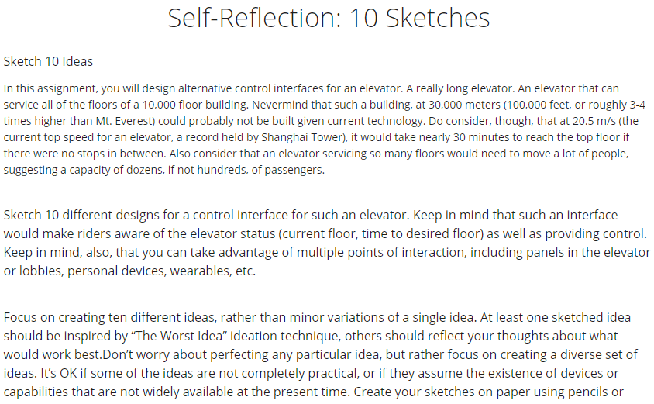

Slide 30
scenarios
stories for design
  communicate with others
  validate other models
  understand dynamics
linearity
  time is linear - our lives are linear
  but don’t show alternatives

Slide 31
scenarios …
what will users want to do?
step-by-step walkthrough
  what can they see (sketches, screen shots)
  what do they do (keyboard, mouse etc.)
  what are they thinking?
use and reuse throughout design

Slide 32
scenario – movie player
Brian would like to see the new film “Moments of Significance” and wants to invite Alison, but he knows she doesn’t like “arty” films. He decides to take a look at it to see if she would like it and so connects to one of the movie sharing networks. He uses his work machine as it has a higher bandwidth connection, but feels a bit guilty. He knows he will be getting an illegal copy of the film, but decides it is OK as he is intending to go to the cinema to watch it. After it downloads to his machine he takes out his new personal movie player. He presses the ‘menu’ button and on the small LCD screen he scrolls using the arrow keys to ‘bluetooth connect’ and presses the select button. On his computer the movie download program now has an icon showing that it has recognised a compatible device and he drags the icon of the film over the icon for the player. On the player the LCD screen says “downloading now”, a percent done indicator and small whirling icon. … … …

Slide 33
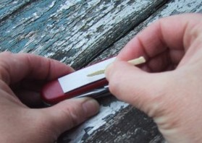
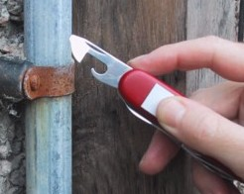
also play act …
mock up device
pretend you are doing it
internet-connected swiss army knife …
but where is that thumb?
use toothpick as stylus

Slide 34
… explore the depths
explore interaction
  what happens when
explore cognition
  what are the users thinking
explore architecture
  what is happening inside

Slide 35
use scenarios to ..
communicate with others
  designers, clients, users
validate other models
  ‘play’ it against other models
express dynamics
  screenshots – appearance
  scenario – behaviour

Slide 36
linearity
Scenarios – one linear path through system
Pros:
  life and time are linear
  easy to understand (stories and narrative are natural)
  concrete (errors less likely)
Cons:
  no choice, no branches, no special conditions
  miss the unintended
So:
  use several scenarios
  use several methods

Slide 38
navigation design
the systems
info and help
management
messages
start
add user
remove user
local structure – single screen
global structure – whole site
main
screen
remove
user
confirm
add user

Slide 39
levels
widget choice
  menus, buttons etc.
screen design
application navigation design
environment
  other apps, O/S

Slide 40
the web …
widget choice
screen design
navigation design
environment
elements and tags
  <a href=“...”>
page design
site structure
the web, browser,
external links

Slide 41
physical devices
widget choice
screen design
navigation design
environment
controls
  buttons, knobs, dials
physical layout
modes of device
the real world

Slide 42
think about structure
within a screen
  later ...
local
  looking from this screen out
global
  structure of site, movement between screens
wider still
  relationship with other applications

Slide 43
local
from one screen looking out

Slide 44
goal seeking
goal
start

Slide 45
goal seeking
goal
start
progress with local knowledge only ...

Slide 46
goal seeking
goal
start
… but can get to the goal

Slide 47
goal seeking
goal
start
… try to avoid these bits!

Slide 48
four golden rules
knowing where you are
knowing what you can do
knowing where you are going
  or what will happen
knowing where you’ve been
  or what you’ve done

Slide 49
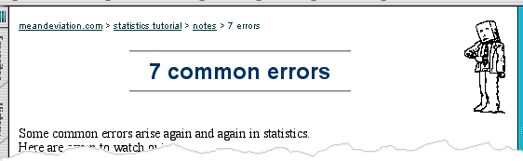
where you are – breadcrumbs
shows path through web site hierarchy
top level category
sub-category
web site
this page
live links
to higher
levels

Slide 50
beware the big button trap
things
other things
more things
the thing from
outer space
where do they go?
  lots of room for extra text!

Slide 51
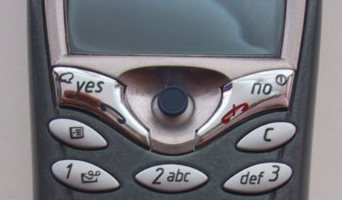
modes
lock to prevent accidental use …
  remove lock - ‘c’ + ‘yes’ to confirm
  frequent practiced action
if lock forgotten
  in pocket ‘yes’ gets pressed
  goes to phone book
  in phone book …
  ‘c’ – delete entry
  ‘yes’ – confirm
  … oops !

Slide 52
global
between screens
within the application

Slide 53
hierarchical diagrams
the system
info and help
management
messages
add user
remove user

Slide 54
hierarchical diagrams ctd.
parts of application
  screens or groups of screens
typically functional separation
the systems
info and help
management
messages
add user
remove user

Slide 55
navigating hierarchies
deep is difficult!
misuse of Miller’s 7 ± 2
  short term memory, not menu size
optimal?
  many items on each screen
  but structured within screen
see /e3/online/menu-breadth/

Slide 56
think about dialogue
what does it mean in UI design?
Minister: do you name take this woman …
Man: I do
Minister: do you name take this man …
Woman: I do
Minister: I now pronounce you man and wife

Slide 57
think about dialogue
what does it mean in UI design?
  marriage service
    general flow, generic – blanks for names
    pattern of interaction between people
  computer dialogue
    pattern of interaction between users and system
    but details differ each time
Minister: do you name take this woman …

Slide 58
network diagrams
main
screen
remove
user
confirm
add user
show different paths through system

Slide 59
network diagrams ctd.
what leads to what
what happens when
including branches
more task oriented then hierarchy
main
screen
remove
user
confirm
add user

Slide 60
wider still
between applications
and beyond ...

Slide 61
wider still …
style issues:
  platform standards, consistency
functional issues
  cut and paste
navigation issues
  embedded applications
  links to other apps … the web

Slide 63
screen design and layout
✓
Dix , Alan
Finlay, Janet
Abowd, Gregory
Beale, Russell
basic principles
grouping, structure, order
alignment
use of white space
ABCDEFHIJKLM
NOPQRSTUVWXYZ

Slide 64
basic principles
ask
  what is the user doing?
think
  what information, comparisons, order
design
  form follows function

Slide 65
available tools
grouping of items
order of items
decoration - fonts, boxes etc.
alignment of items
white space between items

Slide 66
grouping and structure
logically together ⇒ physically together
Billing details:
Name
Address: …
Credit card no
Delivery details:
Name
Address: …
Delivery time
Order details:
item quantity cost/item cost
size 10 screws (boxes) 7 3.71 25.97
…… … … …

Slide 67
order of groups and items
think! - what is natural order
should match screen order!
  use boxes, space etc.
  set up tabbing right!
instructions
  beware the cake recipie syndrome!
  … mix milk and flour, add the fruit
  after beating them

Slide 68
decoration
use boxes to group logical items
use fonts for emphasis, headings
but not too many!!
ABCDEFHIJKLM
NOPQRSTUVWXYZ

Slide 69
alignment - text
you read from left to right (English and European)
⇒ align left hand side
boring but
readable!
Willy Wonka and the Chocolate Factory
Winston Churchill - A Biography
Wizard of Oz
Xena - Warrior Princess
Willy Wonka and the Chocolate Factory
Winston Churchill - A Biography
Wizard of Oz
Xena - Warrior Princess
fine for special effects but hard to scan

Slide 70
alignment - names
Usually scanning for surnames ⇒ make it easy!
✗
✓
Alan Dix
Janet Finlay
Gregory Abowd
Russell Beale
Dix , Alan
Finlay, Janet
Abowd, Gregory
Beale, Russell
✓
Alan Dix
Janet Finlay
Gregory Abowd
Russell Beale

Slide 71

alignment - numbers
think purpose!
which is biggest?
532.56
179.3
256.317
15
73.948
1035
3.142
497.6256

Slide 72
alignment - numbers
visually:
long number = big number
align decimal points
or right align integers
627.865
1.005763
382.583
2502.56
432.935
2.0175
652.87
56.34

Slide 73
multiple columns
scanning across gaps hard:
(often hard to avoid with large data base fields)
sherbert 75
toffee 120
chocolate 35
fruit gums 27
coconut dreams 85

Slide 74
multiple columns - 2
use leaders
sherbert 75
toffee 120
chocolate 35
fruit gums 27
coconut dreams 85

Slide 75
multiple columns - 3
or greying (vertical too)
sherbert 75
toffee 120
chocolate 35
fruit gums 27
coconut dreams 85

Slide 76
multiple columns - 4
or even (with care!) ‘bad’ alignment
sherbert 75
toffee 120
chocolate 35
fruit gums 27
coconut dreams 85

Slide 77
white space - the counter
WHAT YOU SEE

Slide 78
white space - the counter
WHAT YOU SEE
THE GAPS BETWEEN

Slide 79
space to separate

Slide 80
space to structure

Slide 81
space to highlight

Slide 82

physical controls
grouping of items
  defrost settings
  type of food
  time to cook
defrost settings
type of food
time to cook

Slide 83
physical controls
grouping of items
order of items
    type of heating
    temperature
    time to cook
    start
1) type of heating
1
2) temperature
3) time to cook
2
4) start
3
4

Slide 84
physical controls
grouping of items
order of items
decoration
  different colours
  for different functions
  lines around related
  buttons
different colours for different functions
lines around related
buttons (temp up/down)

Slide 85
physical controls
grouping of items
order of items
decoration
alignment
  centered text in buttons
  ? easy to scan ?
centred text in buttons
? easy to scan ?

Slide 86
physical controls
grouping of items
order of items
decoration
alignment
white space
  gaps to aid grouping
gaps to aid grouping

Slide 88
user action and control
entering information
knowing what to do
affordances

Slide 89
entering information
Name:
Alan Dix
Address:
Lancaster
forms, dialogue boxes
  presentation + data input
  similar layout issues
  alignment - N.B. different label lengths
logical layout
  use task analysis (ch15)
  groupings
  natural order for entering information
    top-bottom, left-right (depending on culture)
    set tab order for keyboard entry
✓
Name:
Alan Dix
Address:
Lancaster
?
Name:
Alan Dix
Address:
Lancaster
N.B. see extra slides for widget choice

Slide 90
knowing what to do
what is active what is passive
  where do you click
  where do you type
consistent style helps
  e.g. web underlined links
labels and icons
  standards for common actions
  language – bold = current state or action

Slide 91
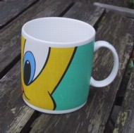
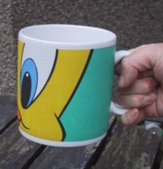
affordances
mug handle
psychological term
for physical objects
  shape and size suggest actions
    pick up, twist, throw
  also cultural – buttons ‘afford’ pushing
for screen objects
  button–like object ‘affords’ mouse click
  physical-like objects suggest use
culture of computer use
  icons ‘afford’ clicking
  or even double clicking … not like real buttons!
‘affords’
grasping

Slide 92
appropriate appearance
presenting information
aesthetics and utility
colour and 3D
localisation & internationalisation

Slide 93
presenting information
purpose matters
  sort order (which column, numeric alphabetic)
  text vs. diagram
  scatter graph vs. histogram
use paper presentation principles!
but add interactivity
  softens design choices
    e.g. re-ordering columns
    ‘dancing histograms’ (chap 21)
name
name
size
size
size
chap1
chap10
chap11
chap12
chap13
chap14
…
chap10
chap5
chap1
chap14
chap20
chap8
…
17
12
51
262
83
22
…
12
16
17
22
27
32
…

Slide 94
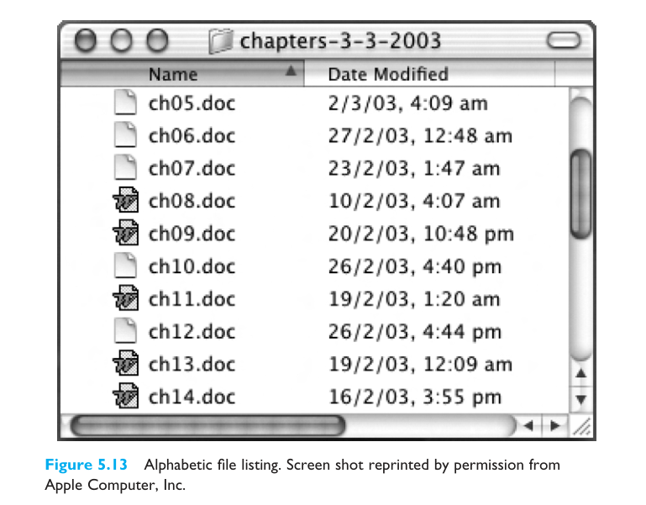

Slide 95

aesthetics and utility
aesthetically pleasing designs
  increase user satisfaction and improve productivity
beauty and utility may conflict
  mixed up visual styles ⇒ easy to distinguish
  clean design – little differentiation ⇒ confusing
  backgrounds behind text
  … good to look at, but hard to read
but can work together
  e.g. the design of the counter
  in consumer products – key differentiator (e.g. iMac)

Slide 96
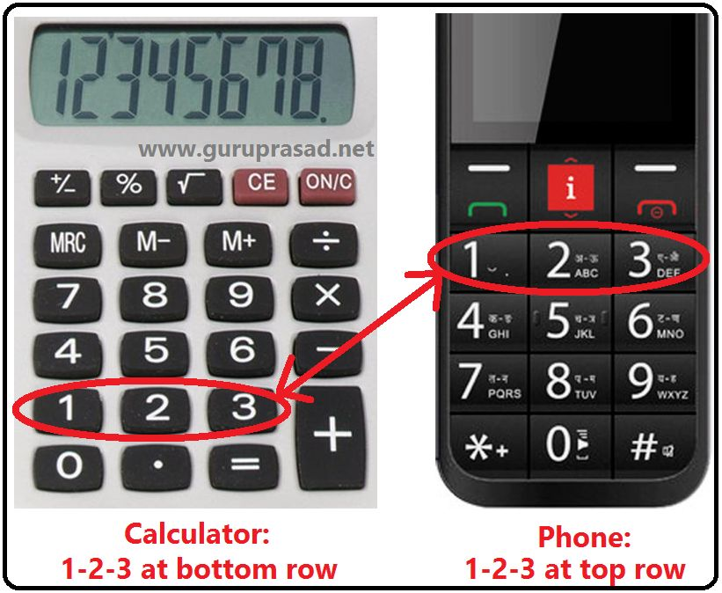

Slide 97

colour and 3D
both often used very badly!
colour
  older monitors limited palette
  colour over used because ‘it is there’
  beware colour blind!
  use sparingly to reinforce other information
3D effects
  good for physical information and some graphs
  but if over used …
  e.g. text in perspective!! 3D pie charts

Slide 98
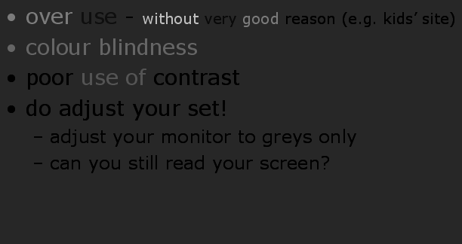
bad use of colour
over use - without very good reason (e.g. kids’ site)
colour blindness
poor use of contrast
do adjust your set!
  adjust your monitor to greys only
  can you still read your screen?

Slide 99
across countries and cultures
localisation & internationalisation
  changing interfaces for particular cultures/languages
globalisation
  try to choose symbols etc. that work everywhere
simply change language?
  use ‘resource’ database instead of literal text
  … but changes sizes, left-right order etc.
deeper issues
  cultural assumptions and values
  meanings of symbols
  e.g tick and cross … +ve and -ve in some cultures
  … but … mean the same thing (mark this) in others
✓
✗

Slide 101
prototyping

Slide 102
iteration and prototyping
getting better …
… and starting well

Slide 103
prototyping
you never get it right first time
if at first you don’t succeed …
OK?
design
prototype
evaluate
done!
re-design

Slide 104
pitfalls of prototyping
moving little by little … but to where
Malverns or the Matterhorn?
1. need a good start point
2. need to understand what is wrong

